Slide 1



Vision-Based PPE Detection for Worker Safety ( USING YOLO7)
CAPSTONE PROJECT
TEAM 4: A.I SHIELDED
- MOHAMED MOHAMED
- SUMESH SURENDAN
- CHEYENNE HATHAWAY
- BRYANNA WALLACE

Slide 2
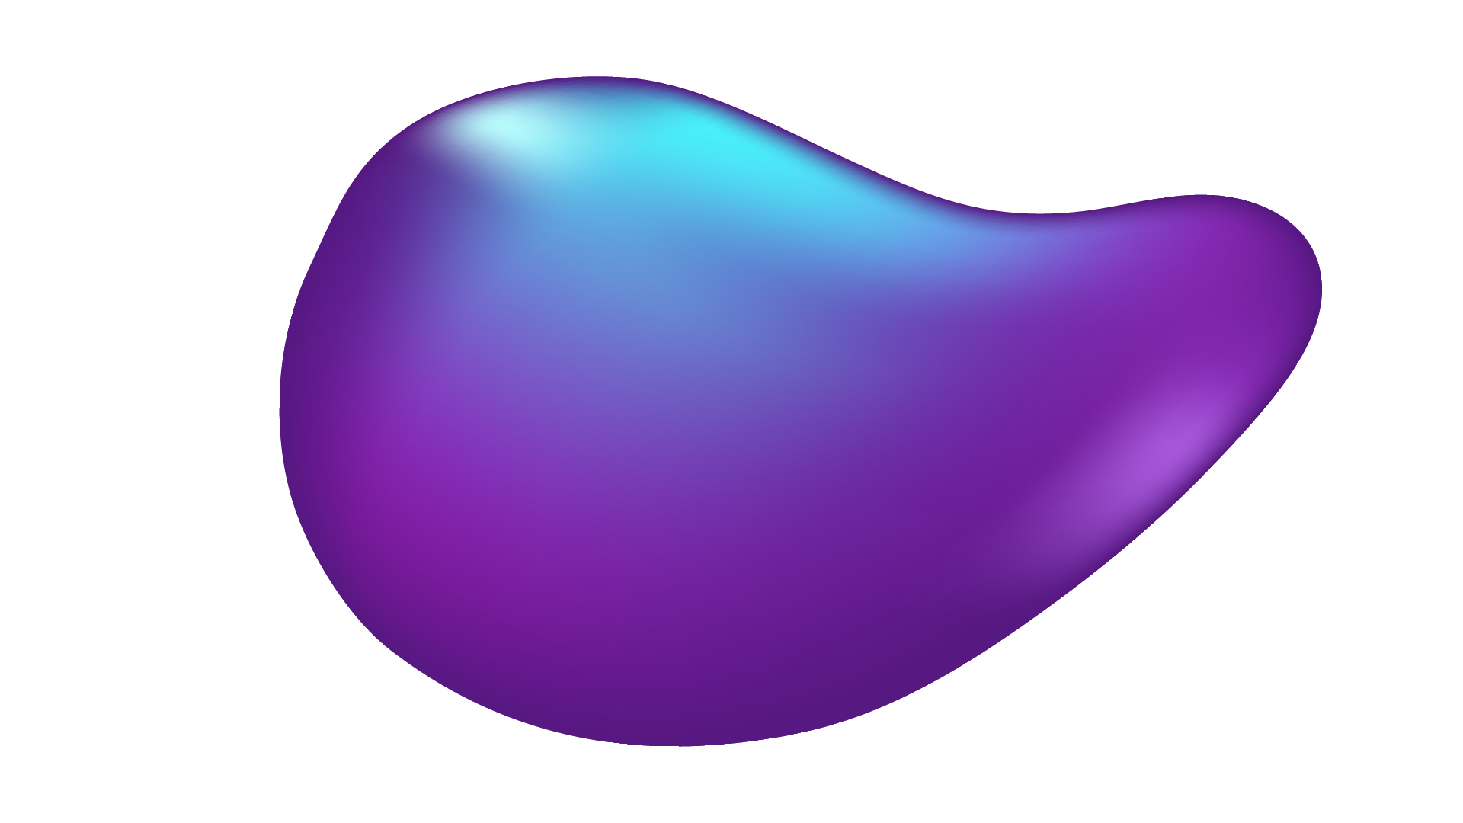
TABLE OF CONTENTS
01
02
03
04
05
ABOUT THE PROJECT
PROJECT GOALS
MAJOR REQUIREMENTS
PROJECT STAGES
PROJECT RESULTS

Slide 3


01
ABOUT THE PROJECT
PPE Detection system using Yolo 7

Slide 4
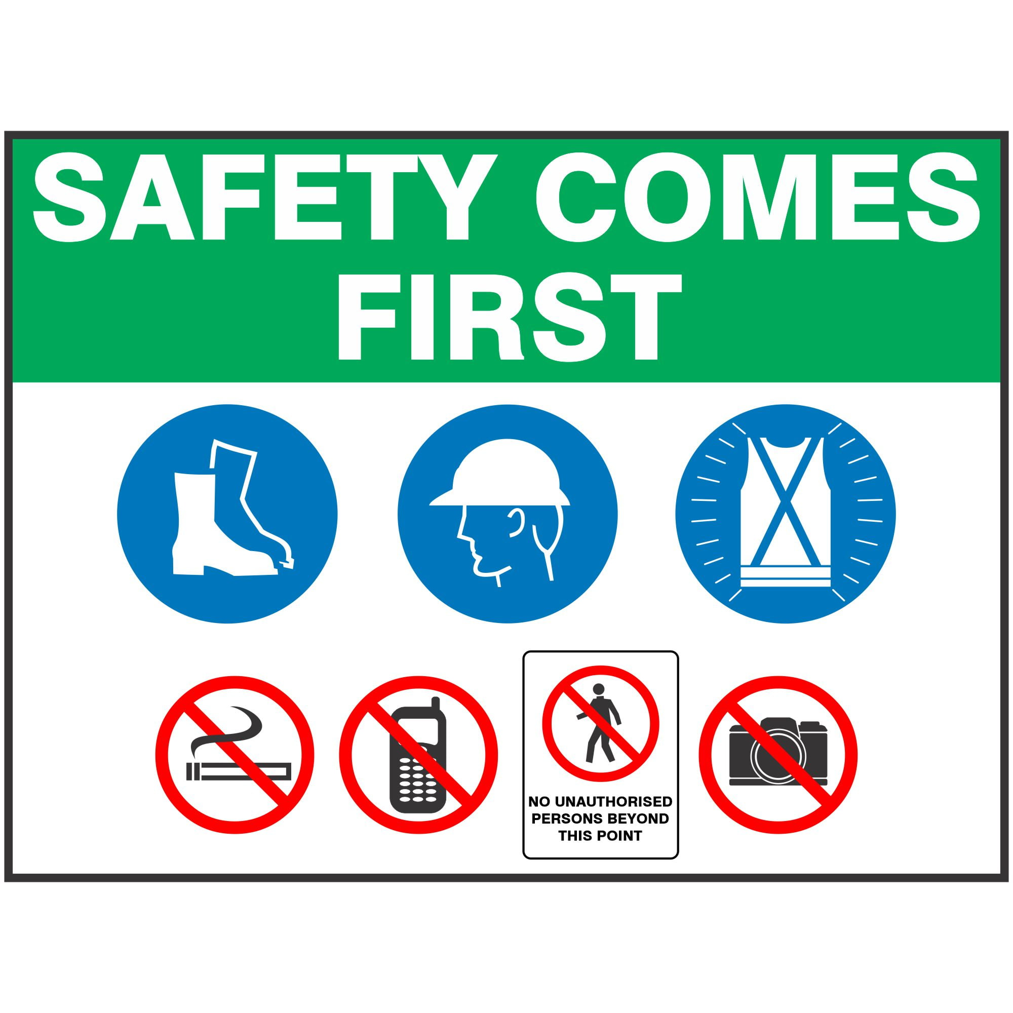
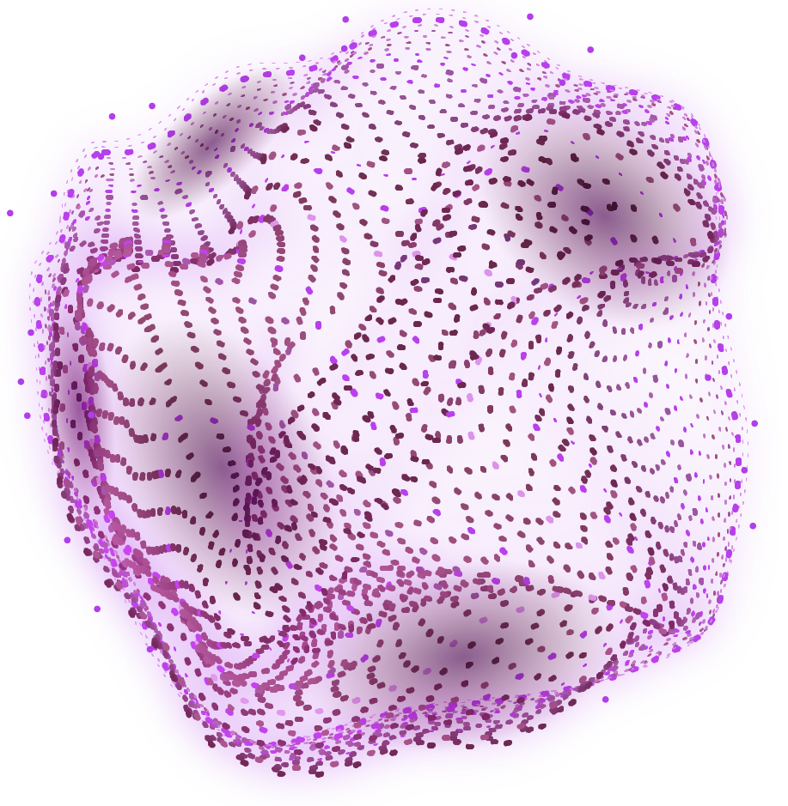
SAFETY FIRST

Slide 5
Safety always comes first, from refineries and factories, to universities and other public spaces. With this is mind, we tried to provide suitable solutions to aid in a more safety conscious environment.

Slide 6
2.6 M
2.7 per 100
56 %
Non-fatal workplace injuries were reported in 2021
Full-time equivalent (FTE) workers
Of these injuries were due to a lack of attention to PPE & lack of training

Slide 7
Project Overview
The goal of this machine learning project is to develop a computer vision system that can accurately detect Personal Protective Equipment (PPE) on workers in various industrial settings. This system will help ensure the safety of workers by identifying whether they are wearing the required PPE, such as helmets, gloves, safety vests, and goggles, in real-time.

Slide 8
OUR ASPIRATIONS
NOW
FUTURE
Hiring many HSE inspectors to follow up on workers and the work environment
Build a complete computer vision model that can track the work environment.

Slide 9
PROJECT GOALS
GOAL 1
Adjustable PPE Detection model
GOAL 2
High Accuracy
GOAL 3
Low Cost

Slide 10
MAJOR REQUIREMENTS
DATASET
CAMERA
Need unbiased dataset with large number of images in different positions.
High resolution camera
COMPUTING RESOURCES
SKILLS
High speed computer or platform for model training and deployment
Required skills include but are not limited to knowing how to work with the model and dataset

Slide 11
PROJECT TIMELINE
7. Model Evaluation
8. Model Testing
3. Data Annotation
4. Data Preprocessing
2nd Month
4th Month
1st Month
3rd Month
1. Project Initiation.
2. Data Collection
5. Model Selection
6. Model Development

Slide 12
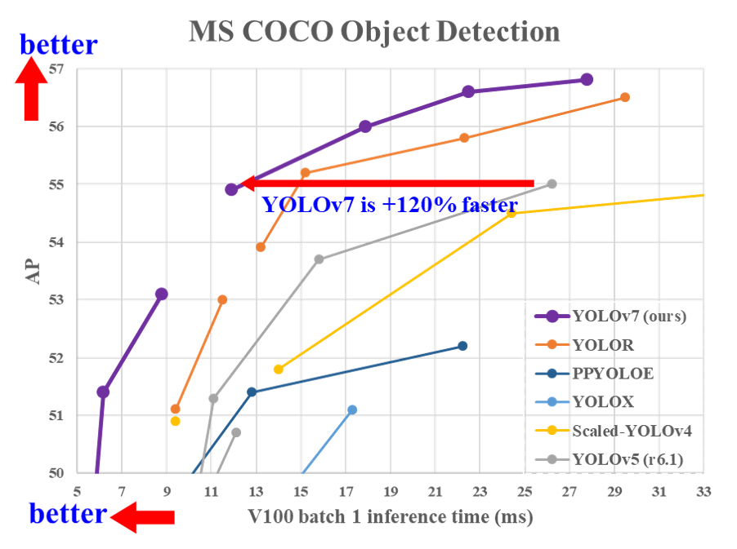
WHAT IS YOLO MODEL? (You Only Look Once)
80
75 M
MS COCO
(Microsoft Common Objects in Context)
Dataset
Objects/ Classes
328 k
Hyperparameters
Images
WongKinYiu/yolov7: Implementation of paper - YOLOv7: Trainable bag-of-freebies sets new state-of-the-art for real-time object detectors (github.com)

Slide 13
02
PROJECT STAGES

Slide 14
PROJECT STAGES
Project Planning
STAGE 1
Data Preparing
STAGE 2
Model Selection & Deploymnt
STAGE 3

Slide 15
STAGE 1
Project planning and obstacles
The journey of this stage began before the selection of the project's actual theme. We discussed several options before settling on a focus. Initially, we considered developing a model capable of detecting weapons and metals within school premises, improve the safety of the children. However, as we delved into the initial phases of project development, we encountered several challenges that rendered the implementation unfeasible due to hardware requirements and costs. Consequently, we made the decision to pivot to our current project topic.

Slide 16
Upon finalizing our new project idea, we faced the task of selecting the appropriate model from a myriad of options available. This stage required a thorough exploration to identify a model that struck the right balance between accuracy and speed, ensuring optimal performance.
Notably, a significant hurdle emerged when we initially planned to execute the project using Nvidia Jetson Nano. Subsequent experimentation revealed its limitations, prompting a reassessment of our approach. We found it necessary to modify our concept, opting for a Cloud-based implementation.

Slide 17
STAGE 2
Data Preparing
This stage stands out as the pivotal phase in constructing our project. As the adage goes, "garbage in, garbage out,“ highlighting the significance of meticulous attention to the date we collected and utilized for the development of our model. Throughout the model training, we harnessed the capabilities of MakeML Dataset, incorporating a pool of 5,000 images featuring workers, some wearing helmets and/or vests, while others were not.

Slide 18
While assembling the data did not present significant challenges, the annotation process did. Unlike the conventional labeling procedure in Pascal format, where an image is solely identified by its class, the YOLO model necessitates precise localization of each class within every image. Annotation, in this context, involves specifying coordinates within the image.
We used the Roboflow platform to help us in this process, as well as some Python code to convert between the two formats.
Roboflow Universe: Open Source Computer Vision Community

Slide 19
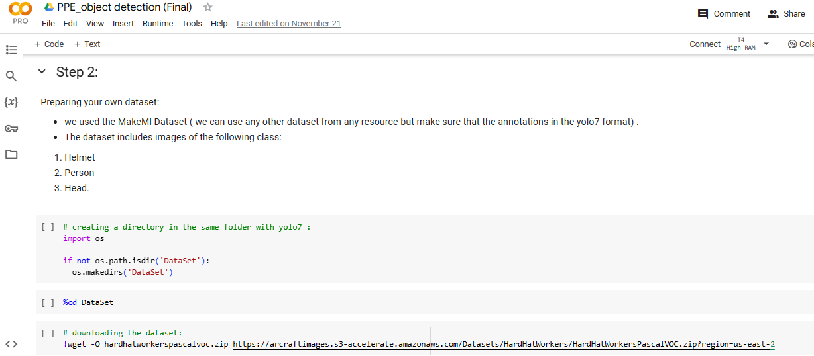
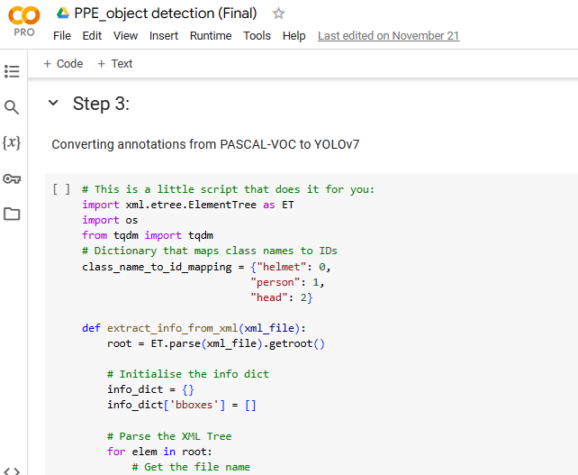
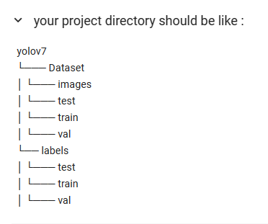
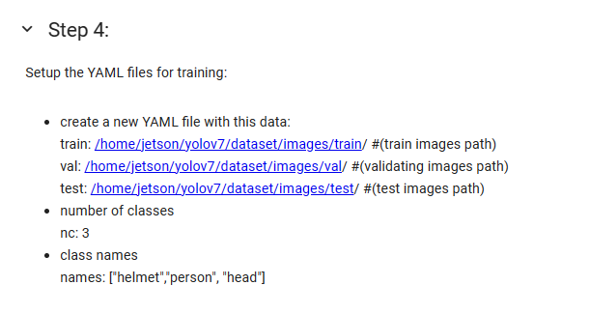

Slide 20
STAGE 3
Model Selection & Deployment
At this stage, we chose the Yolo7 model, the latest version at that time. It is characterized by its speed, allowing it to work in real time, its high accuracy, and most importantly, the possibility of adapting it to more than one class according to need.
We utilized the pre-existing weights of the model, a practice known as transfer learning, initially trained for a different task. This approach involved retraining the model on our dataset. Upon completion of the training process, we obtained two distinct files: the best model and the last model.

Slide 21
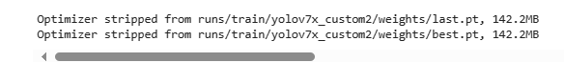
The "best model" file encapsulates the optimal weights and hyperparameters attained during training. This is the version we deployed in our application. The "last model" file serves as a backup, allowing us to retrain the model in the event of low accuracy or suboptimal performance.
Subsequently, we assessed the chosen model's performance on both images and videos, finding its speed and accuracy to be satisfactory. Encouraged by these results, we seamlessly extended the application to real-time live camera .
https://colab.research.google.com/drive/1WmBgjlCczn0svXcYXc51lgHyJJ0p20Y?usp=sharing

Slide 22
03
PROJECT RESULTS

Slide 23
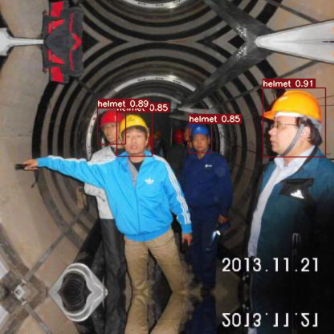
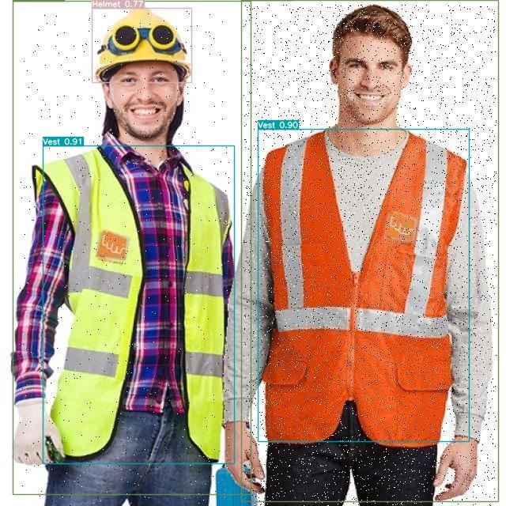

Slide 24
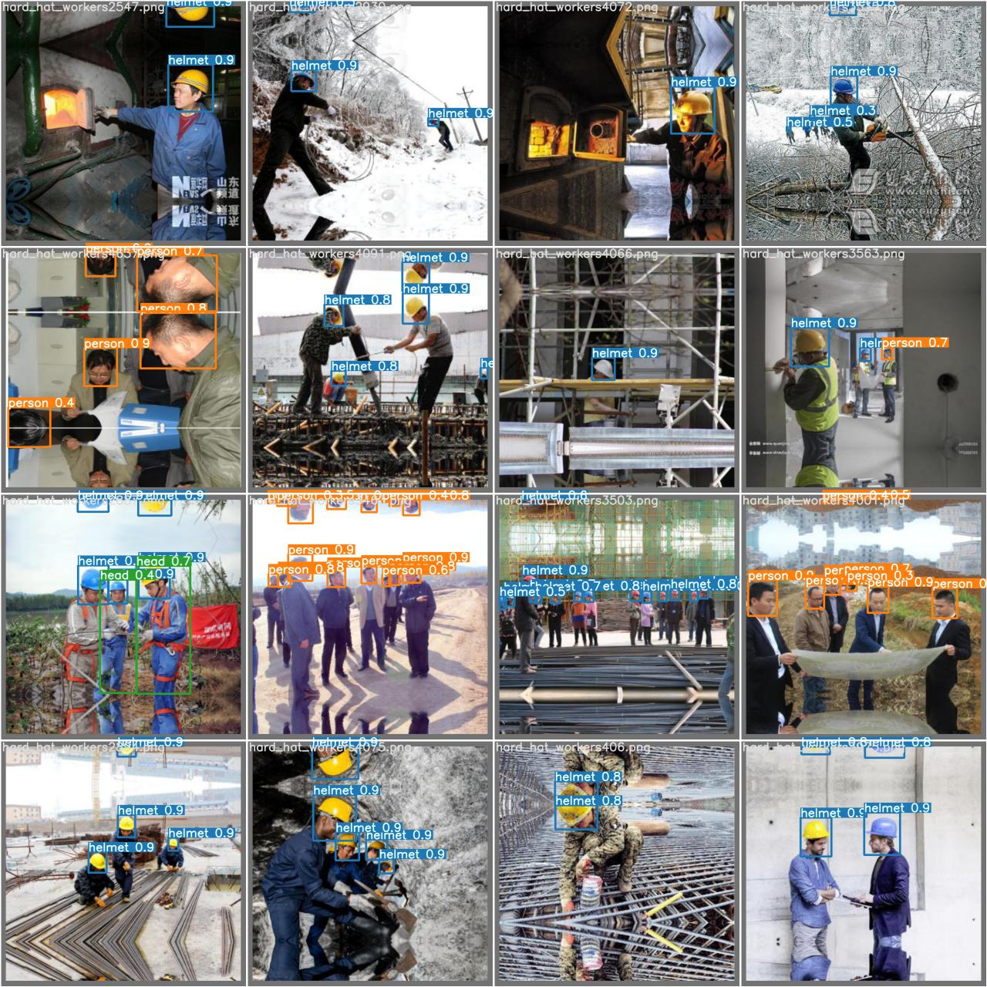
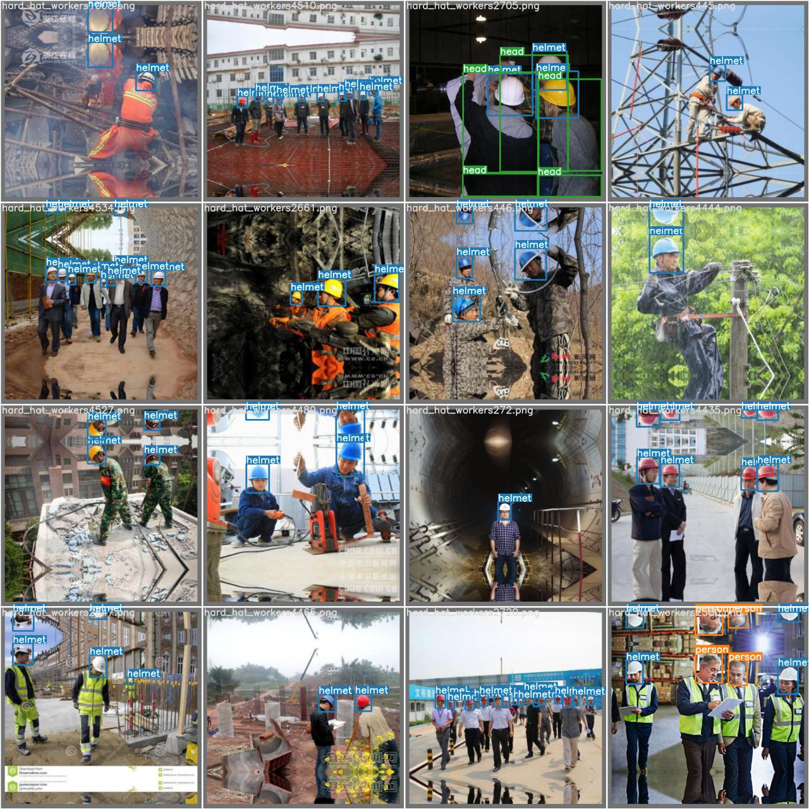
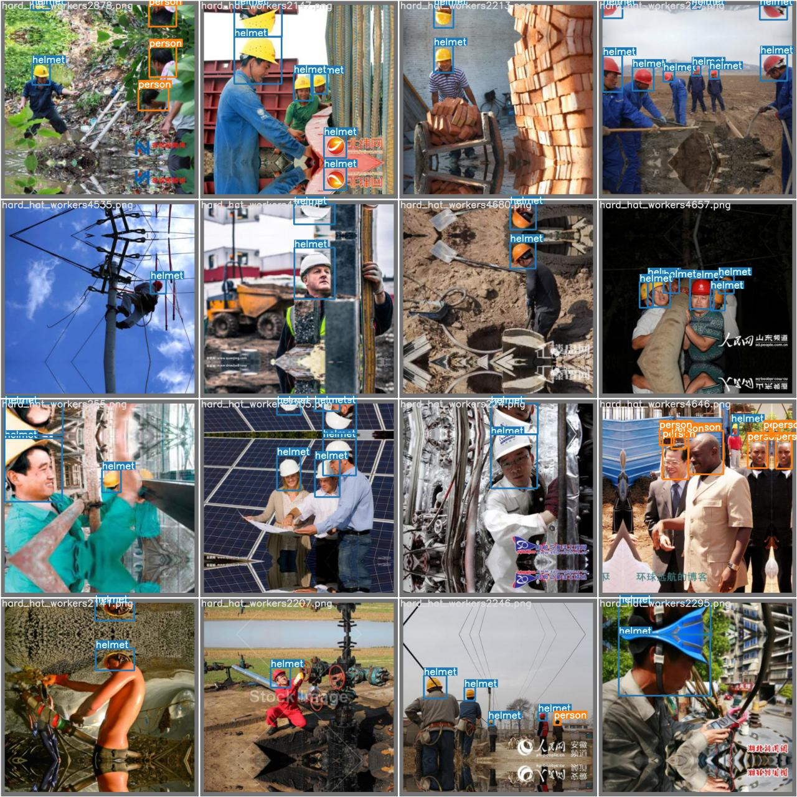

Slide 25
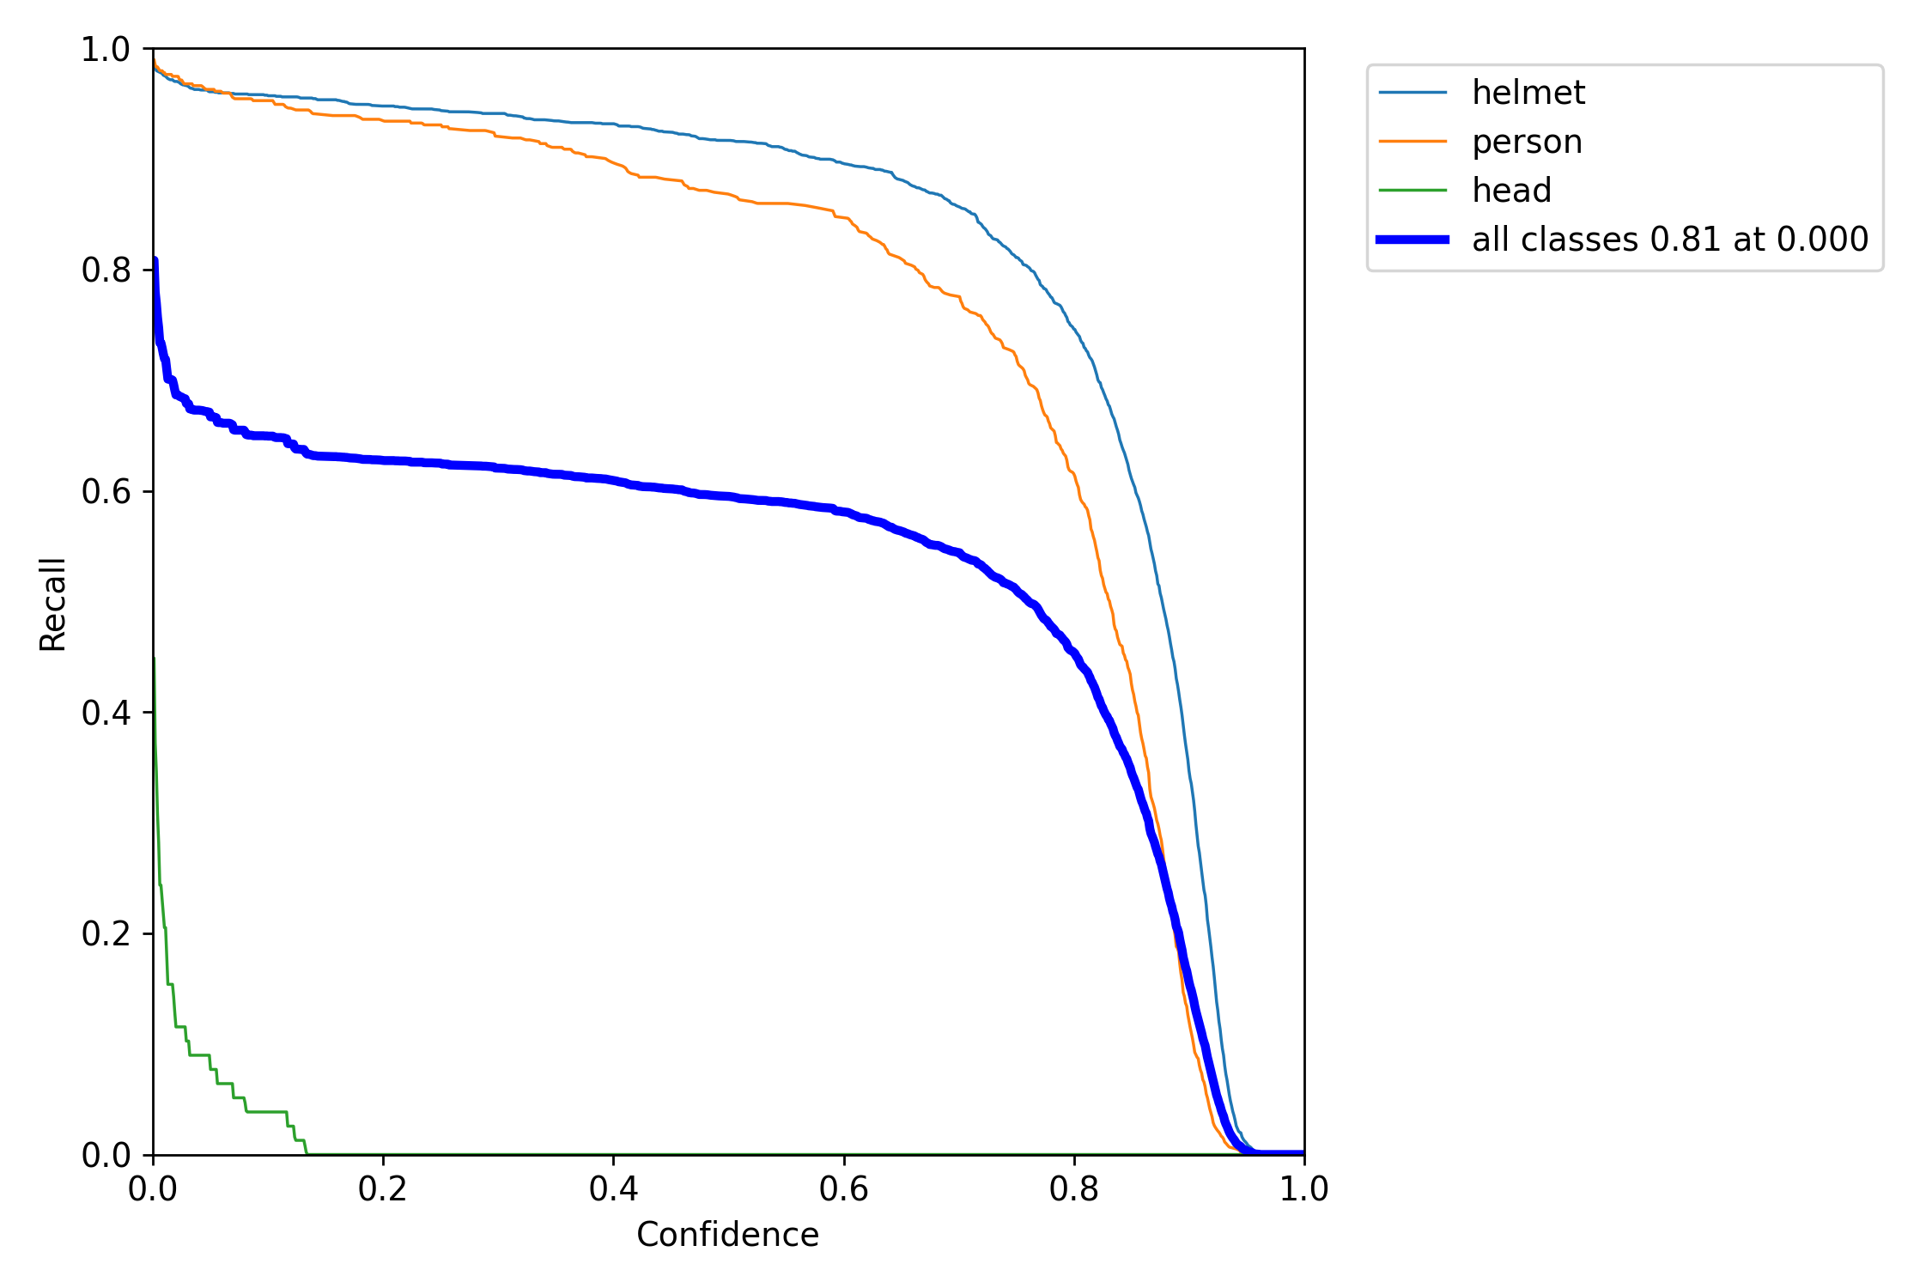
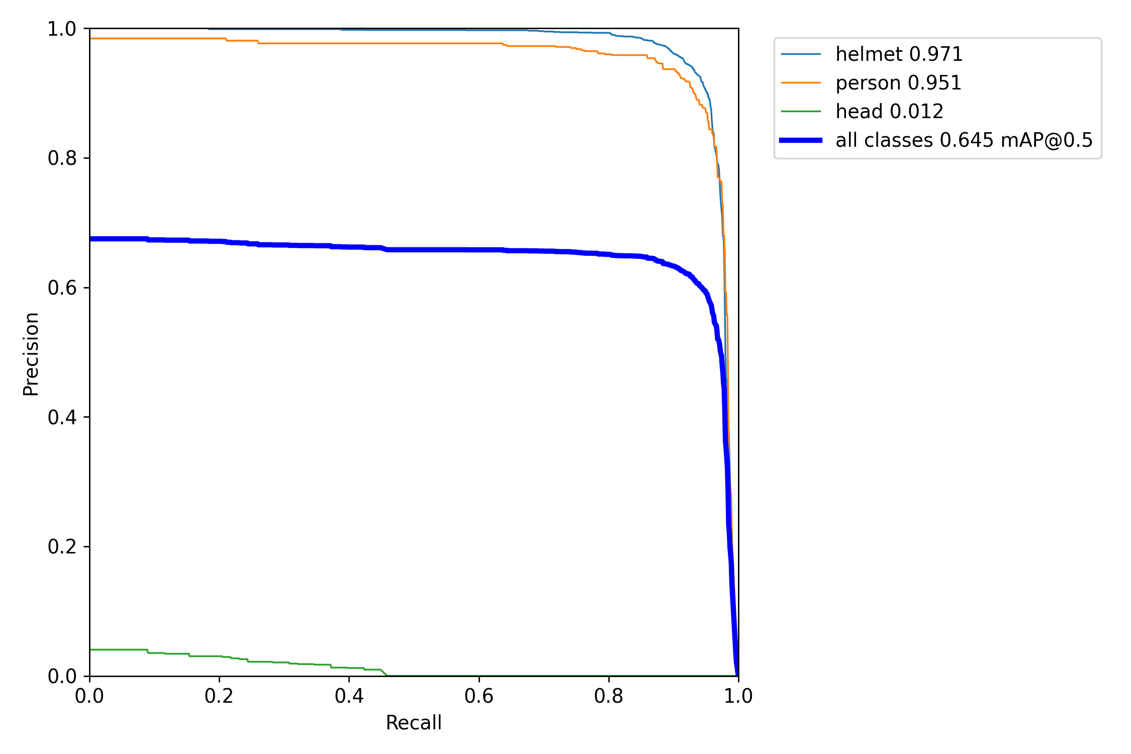
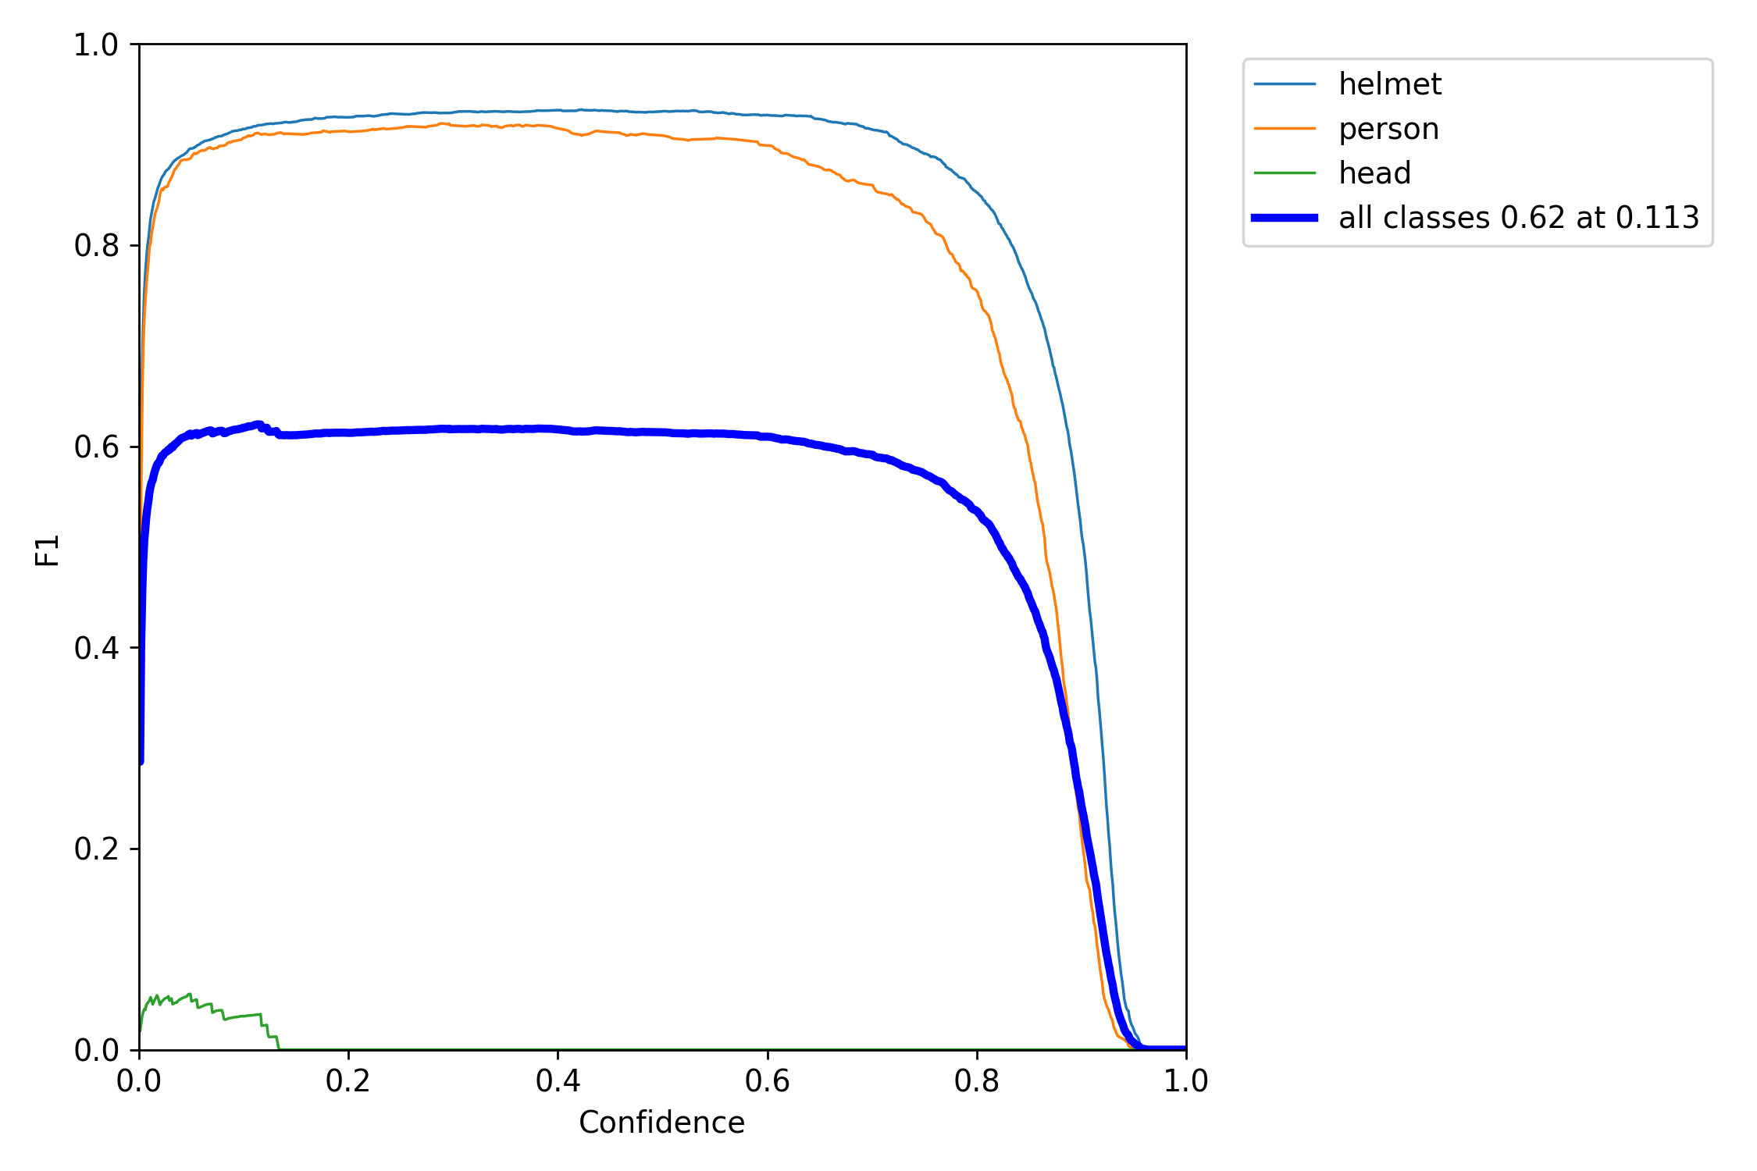
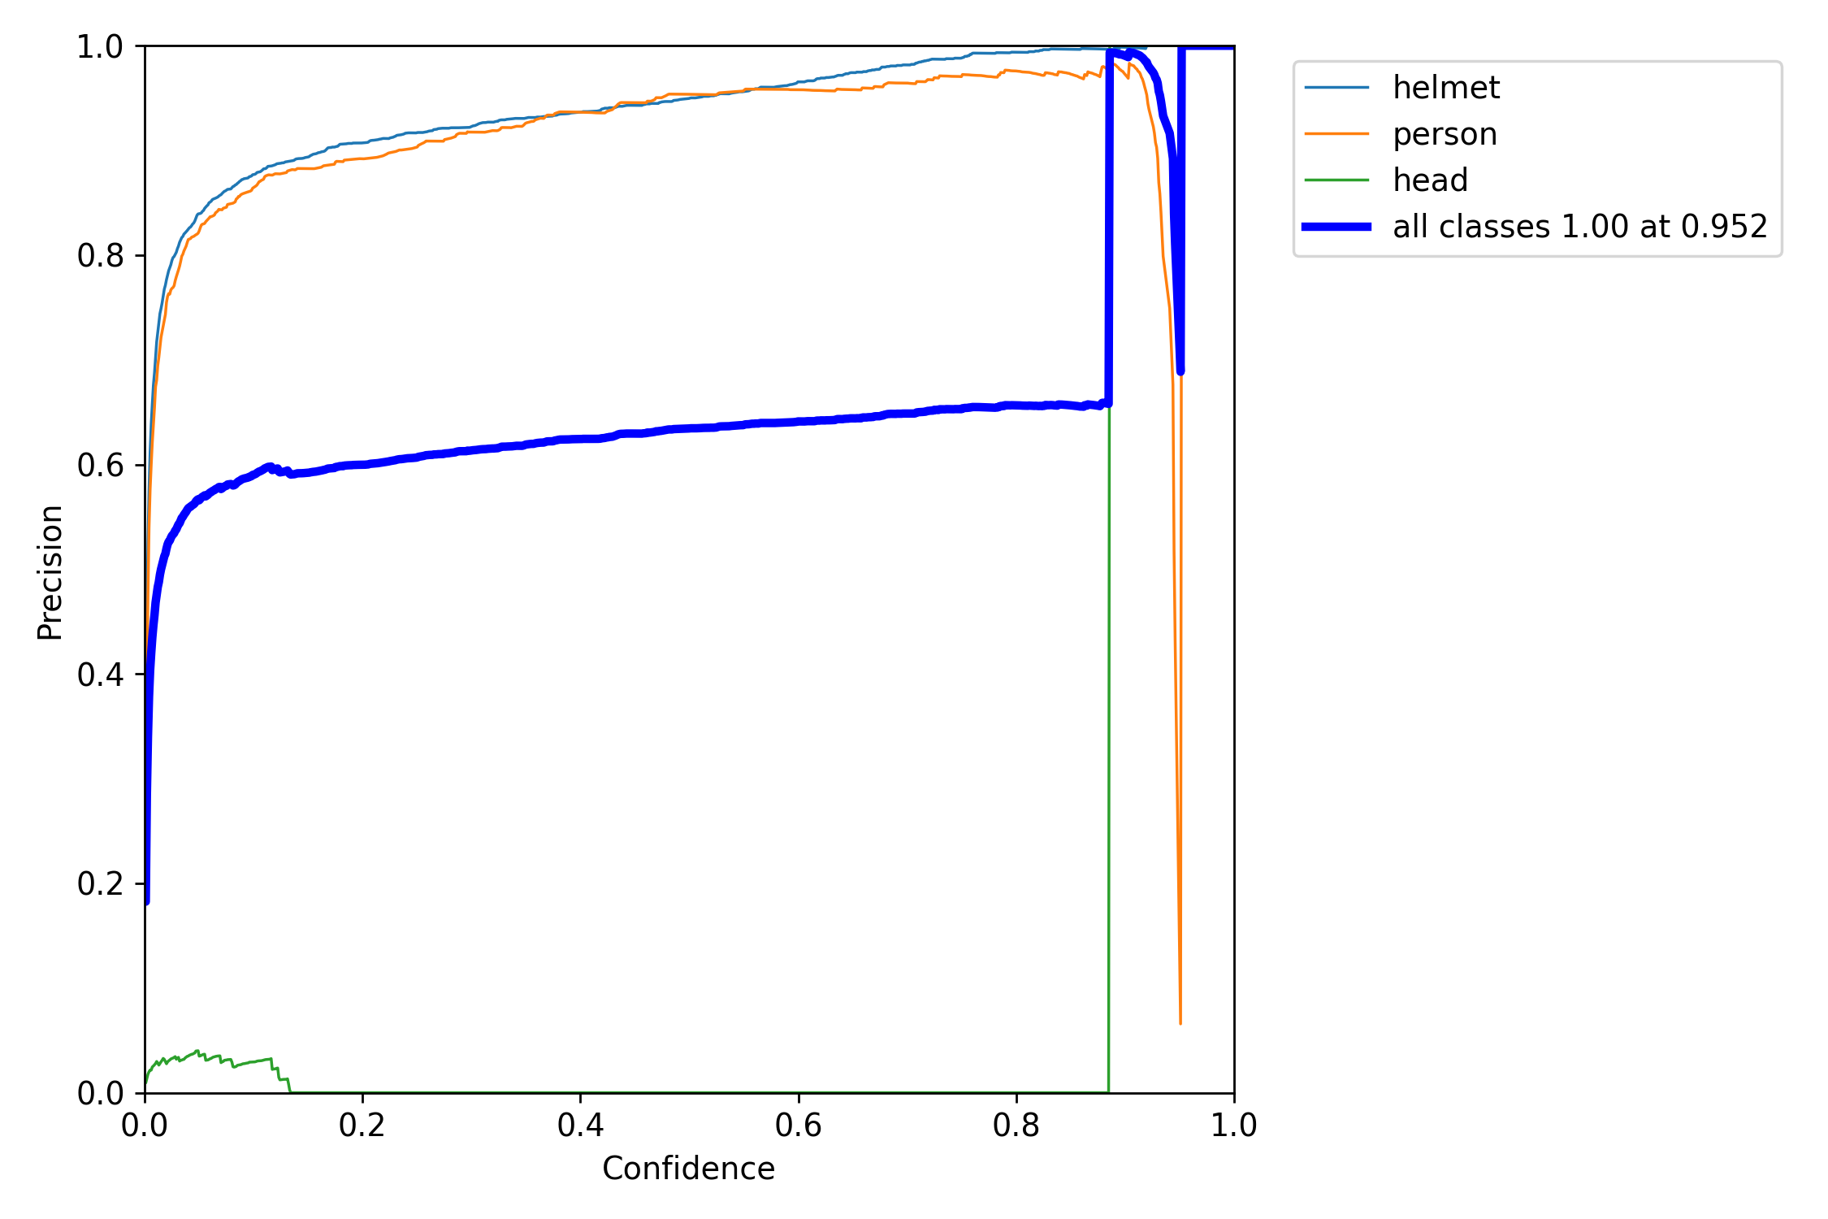
Model Evaluation

Slide 26
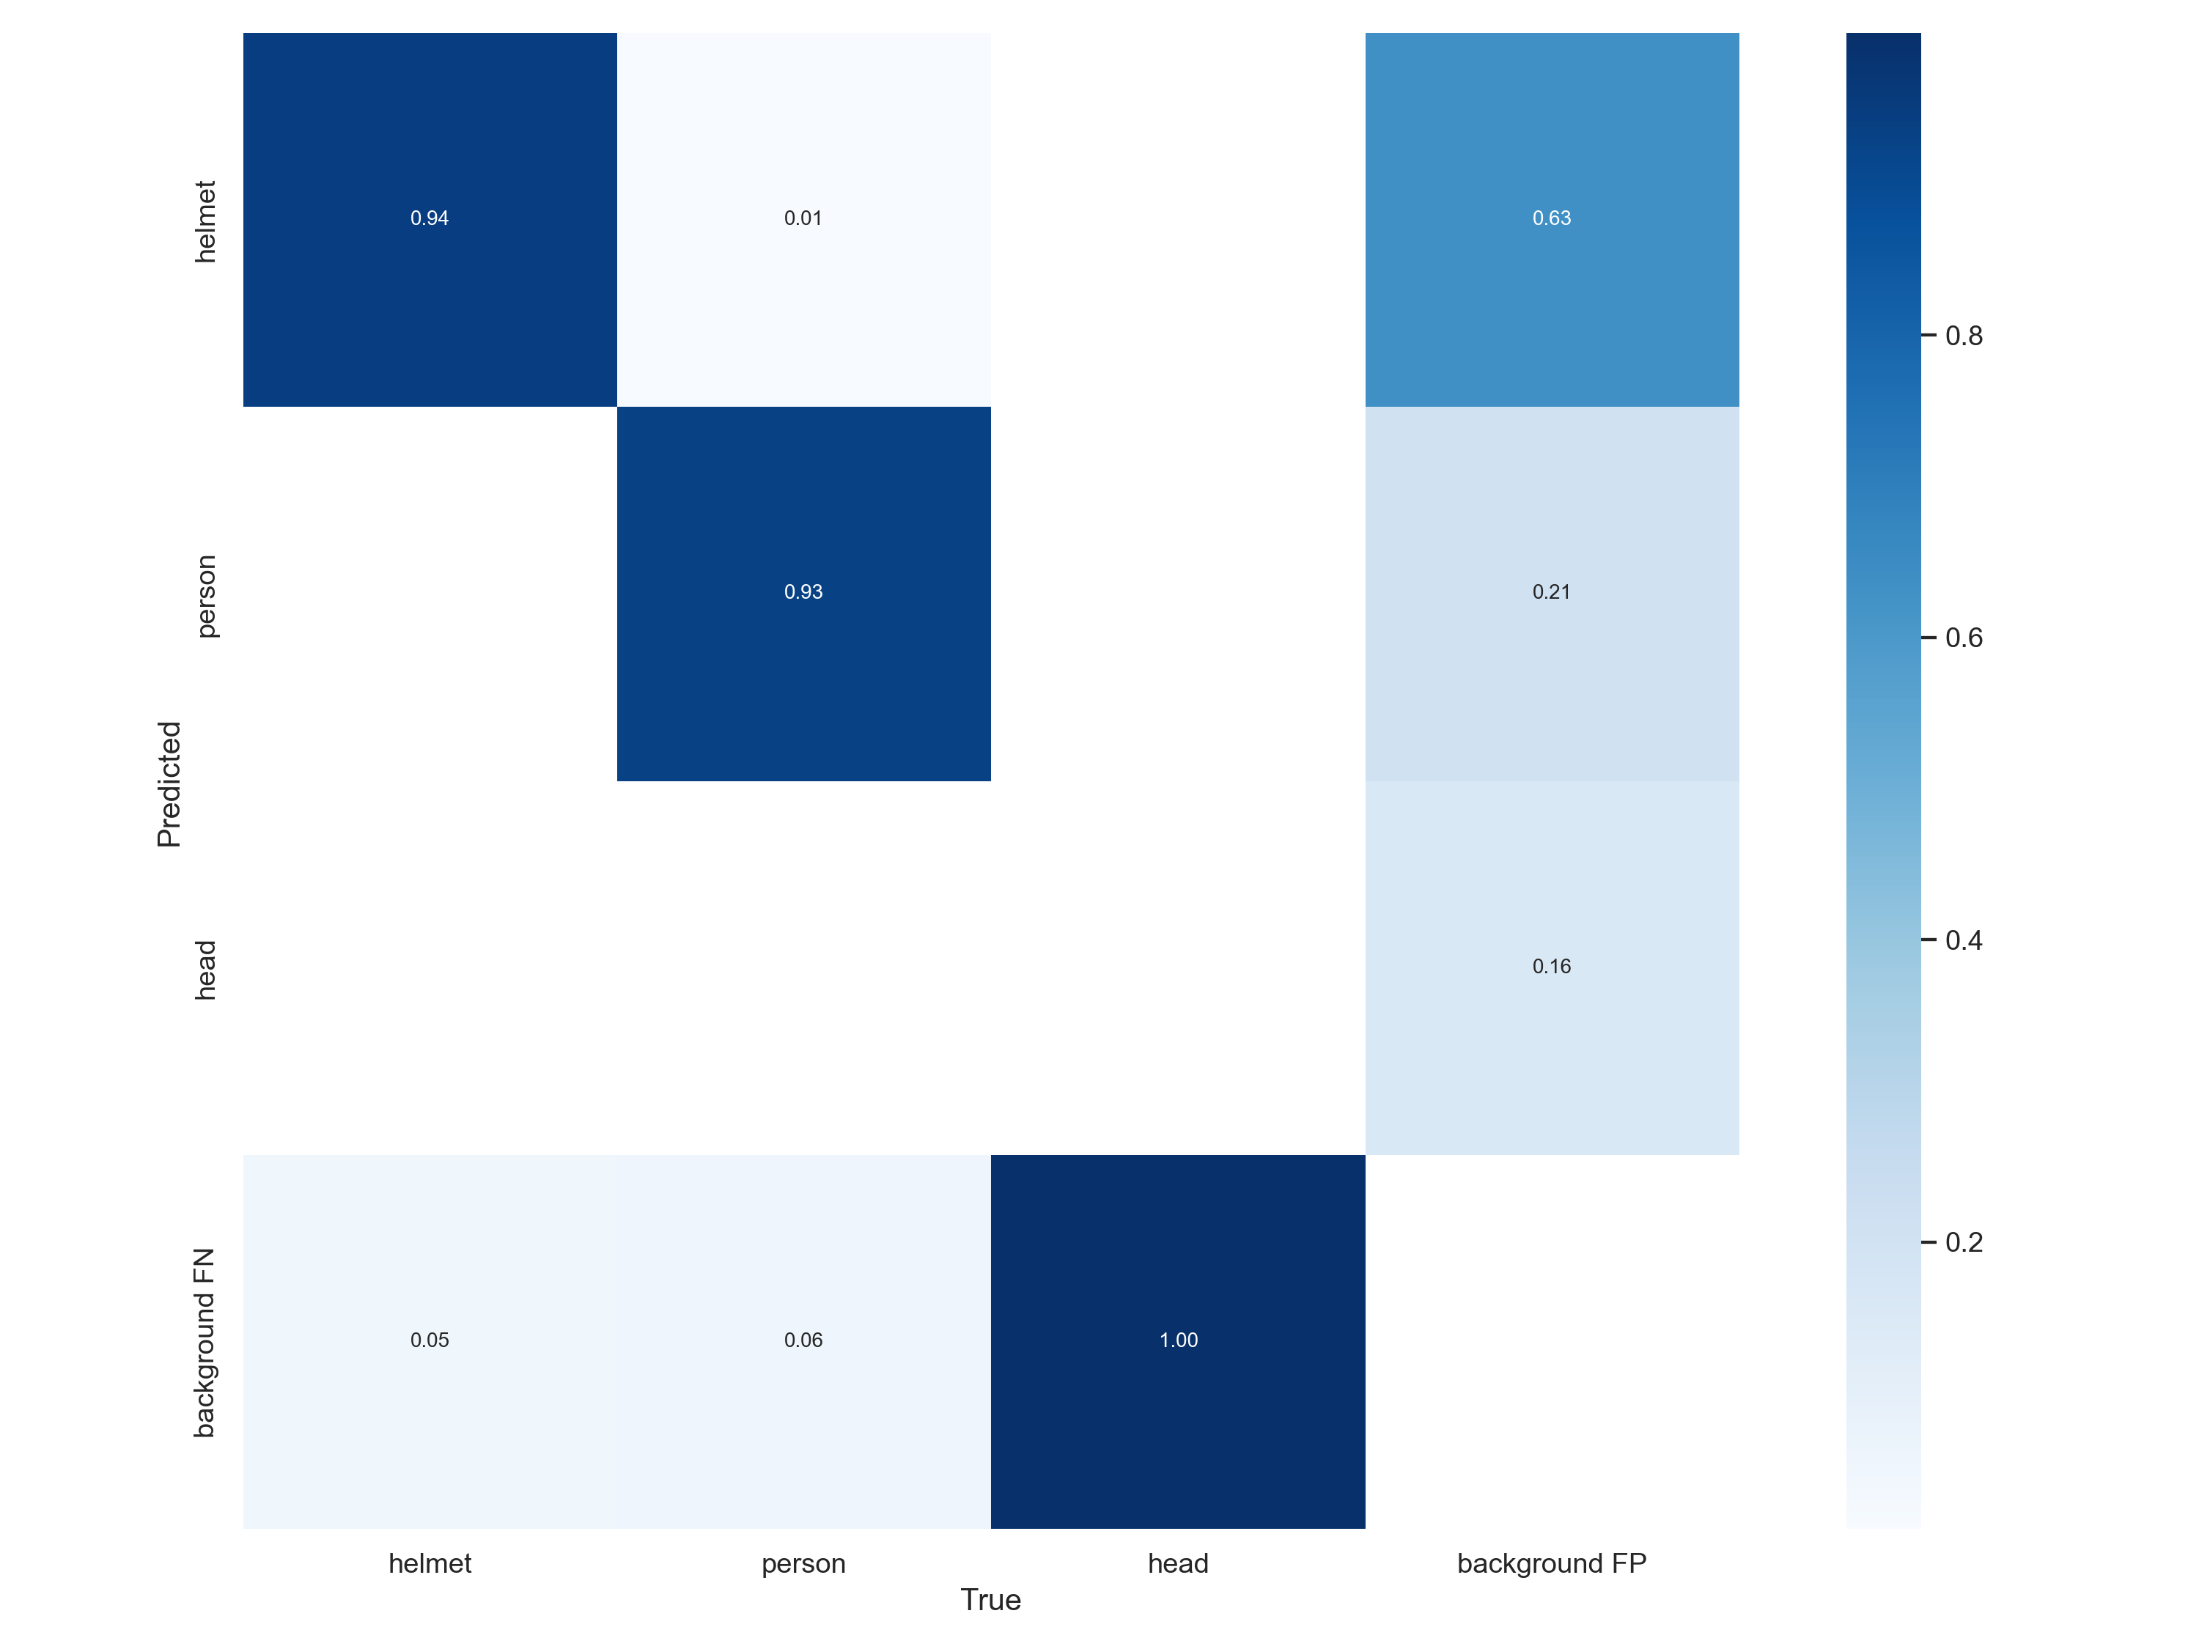
confusion_matrix

Slide 27
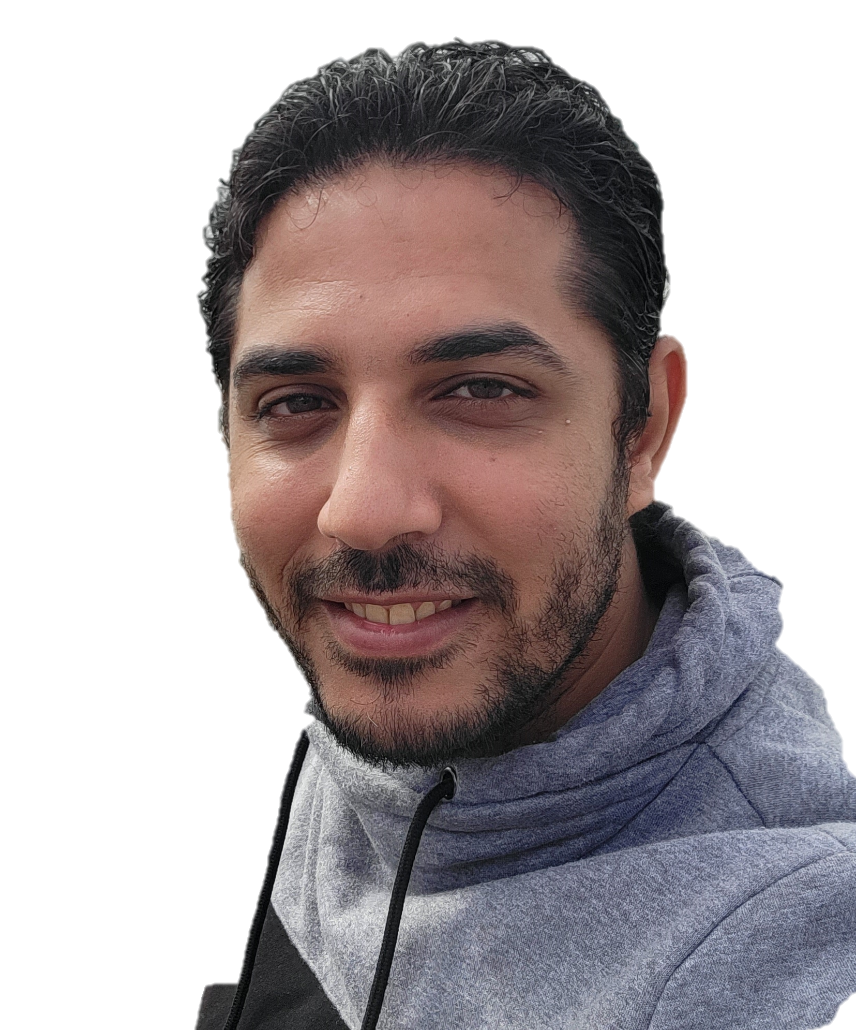
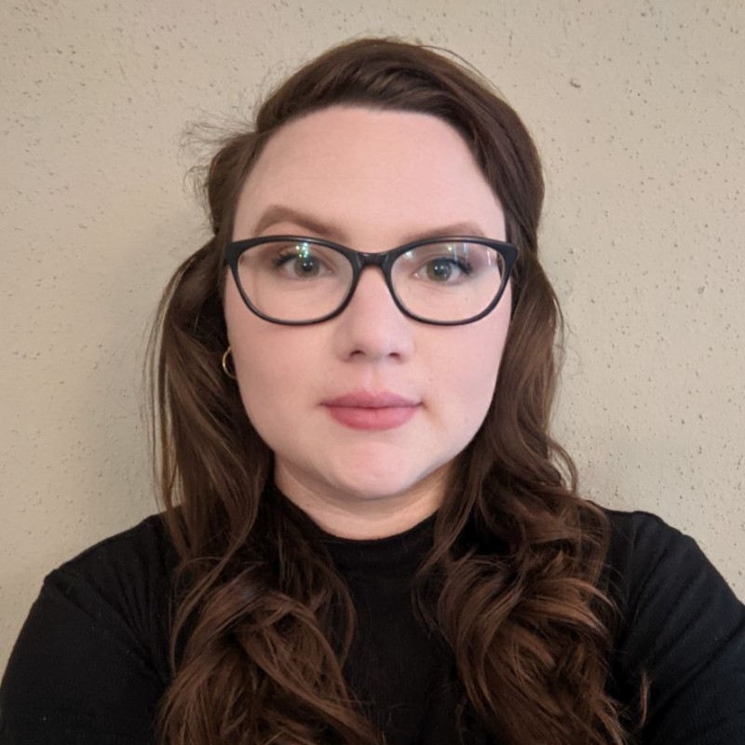

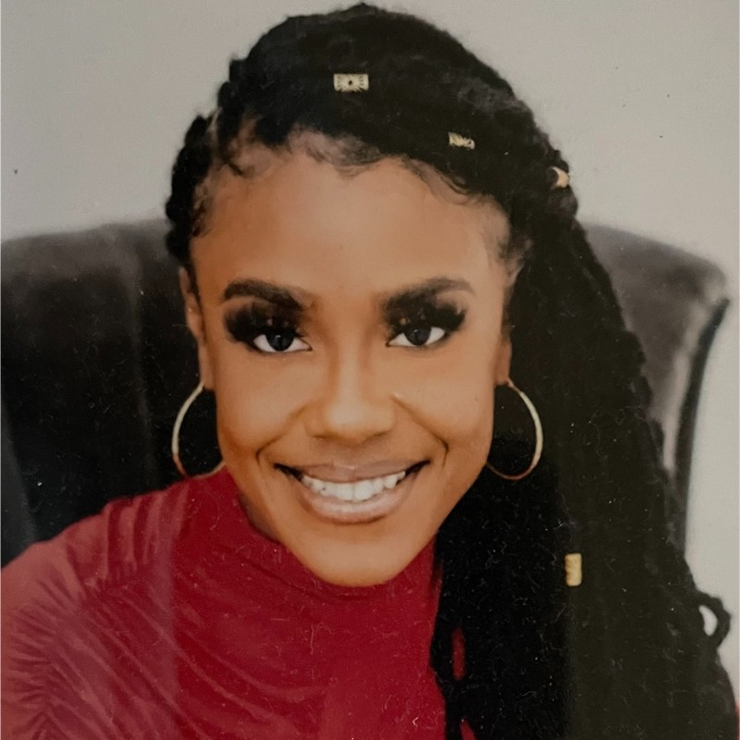
OUR TEAM
Mohamed Mohamed
Cheyenne Hathaway
Team Leader
A.A.S in Artificial Intelligence
A.A.S in Artificial Intelligence
Mohamed (Hussien) Mohamed | LinkedIn
Cheyenne Hathaway | LinkedIn
Sumesh Surendran
Bryanna Wallace
B.A.T. in Artificial Intelligence & Robotics
A.A.S in Artificial Intelligence
Sumesh Surendran | LinkedIn
Bryanna Wallace | LinkedIn

Slide 28

THANKS!
DO YOU HAVE
ANY
QUESTIONS?

